Slide 1


Slide 2
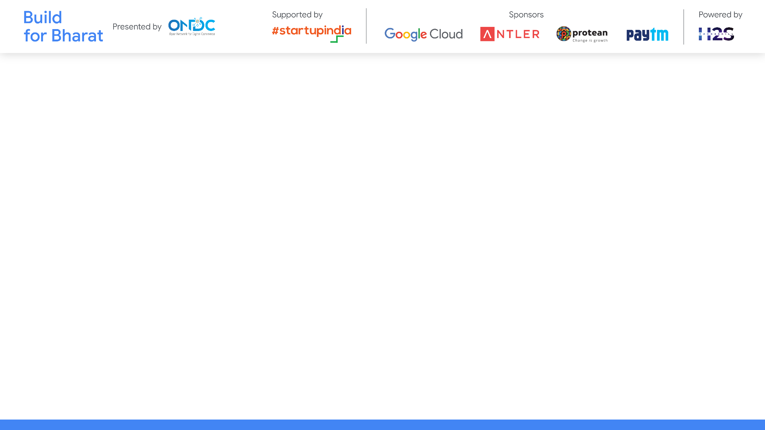
Team Name: uchiha
Team Leader Name: T.LOHITH
Team Member Names: 4
Problem Statement Category: Foundational or Scalable Solution
Problem Statement:
*You can make a copy of the slides. Do not change the template branding.

Slide 3
Architecture & Design for the innovative solution.
Modular architecture that provides flexible integration options.
Tech evaluation would include the following
Reusability - of APIs, algorithms, data sets
Extensibility - to other use-cases
Scalability - working at population scale with optimal capacity & minimal latency
Security - ensuring transactional guarantees
*You can make a copy of the slides. Do not change the template branding.

Slide 4
Define customization&deployment options of your proposed solution:
The proposed catalog scoring solution offers customizable parameters and weights to tailor the assessment according to buyer app preferences. It can be deployed on-premises or in the cloud, ensuring scalability to handle varying catalog volumes. With seamless API integration, the solution can be easily incorporated into existing buyer app systems for real-time assessment. Its modular architecture allows for flexibility and future expansion, while white-labeling options ensure alignment with buyer app branding strategies. Overall, the solution provides a versatile and adaptable approach to catalog quality evaluation for buyer apps.
*You can make a copy of the slides. Do not change the template branding.

Slide 5
Test cases & data (as applicable) against which the eval criteria can be assessed:
Testing compliance with different legal requirements by examining simulated catalog entries.
Ensuring data consistency across various catalog datasets to assess solution adaptability.
Evaluating scalability with increasingly large catalog datasets to measure processing efficiency.
Analyzing parameter weight adjustments' impact on catalog scores using synthetic data.
Validating seamless integration with buyer app systems through end-to-end tests with real catalog data.
*You can make a copy of the slides. Do not change the template branding.

Slide 6
Demonstrate working of the solution to the evaluation team:
"Let's begin by retrieving catalog data from seller apps through APIs or data feeds."
"Next, we preprocess the data to normalize and prepare it for analysis."
"Now, we'll demonstrate how the solution assesses compliance, correctness, and completeness parameters using sample catalog entries."
"After assessing parameters, we assign weights based on their importance and compute weighted scores."
"Let's calculate the overall catalog score by summing up the weighted scores for each parameter."
"We'll now conduct a scalability test to demonstrate the solution's performance with large catalog datasets."
"Integrating with a sample buyer app system, we showcase how catalog scoring results seamlessly appear within the app interface."
*You can make a copy of the slides. Do not change the template branding.

Slide 7
Important Links:-
GitHub Public Repository Link
Link to test cases and data files
*You can make a copy of the slides. Do not change the template branding.

Slide 8


